Slide 1
Risk Management

Slide 2
LEARNING OBJECTIVES
Upon completion of this material, you should be able to:
Define risk management, risk identification, and risk control
Describe how risk is identified and assessed
Assess risk based on probability of occurrence and likely impact
Explain the fundamental aspects of documenting risk via the process of risk assessment
Describe the various risk mitigation strategy options
Identify the categories that can be used to classify controls
Recognize the existing conceptual frameworks for evaluating risk controls and formulate a cost benefit analysis
Describe how to maintain and perpetuate risk controls

Slide 3
An Overview of Risk Management
Risk identification: process of examining an organization’s current information technology security situation
Risk management: process of identifying risk and controlling the risks facing an organization
Risk assessment: is the determination of the extent to which the organization’s information assets are exposed or at risk
Risk control: is the application of controls to reduce the risks to an organization’s data and information system

Slide 4
An Overview of Risk Management
Know Yourself: identify, examine, and understand the information and systems currently in place within your organization
systems that use, store, and transmit information, you know what they are, how they add value to the organization, and to which vulnerabilities they are susceptible
Know the enemy: identifying, examining, and understanding the threats facing the organization
determine which threat aspects directly affect the security of the organization and its information assets

Slide 5
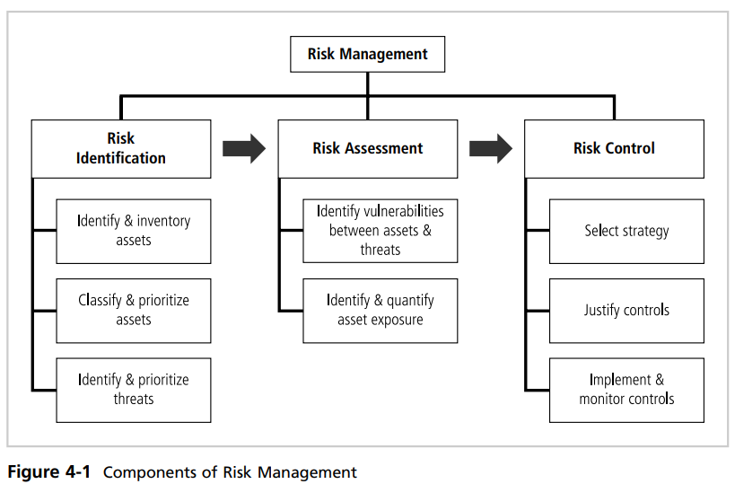
Components of Risk Management

Slide 6
The Roles of the Communities of Interest
Evaluating the risk controls
Determining which control options are cost effective for the organization
Acquiring or installing the needed controls
Ensuring that the controls remain effective

Slide 7
Risk Identification
Risk identification begins with identifying organization’s assets and assessing their values
identify, classify, and prioritize organizations’ information assets

Slide 8
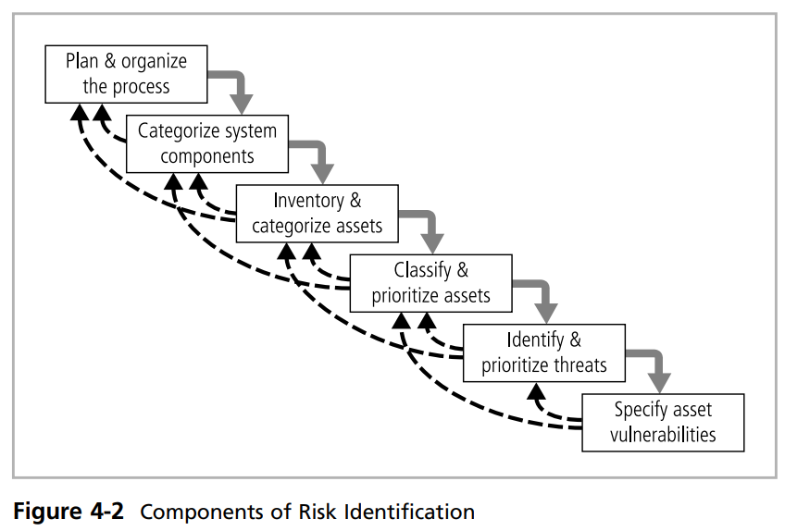
Components of Risk Identification

Slide 9
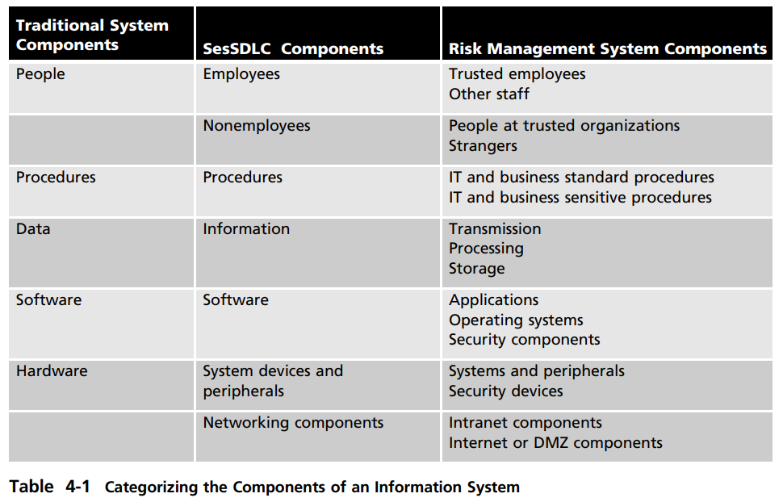
Categorizing the Components of an Information System

Slide 10
Risk Identification
Plan and Organize the Process:
organize a team based on users, managers, IT and InfoSec groups for risk identification
Asset Identification and Inventory:
elements of an organization’s system, such as people, procedures, data and information, software, hardware, and networking elements
People, Procedures, and Data Asset Identification:
People: Position name/number/ID supervisor, security clearance level, special skills
Procedures: Description; intended purpose; relationship to software, hardware, and networking elements; storage location for reference; storage location for update
Data: Classification; owner, creator, and manager, size of data structure, data structure used (sequential or relational) online or offline, location
People with knowledge, experience, and judgment should be assigned the task

Slide 11
Hardware, Software, and Network Asset Identification
Hardware, Software, and Network Asset Identification:
Which attributes of hardware, software, and network assets should be tracked? It depends on the needs of the organization
IP address: This can be a useful identifier for network devices and servers, but does not usually apply to software.
Media access control (MAC) address: MAC addresses are sometimes called electronic serial numbers or hardware addresses.
Serial number: For hardware devices, the serial number can uniquely identify a specific device

Slide 12
Hardware, Software, and Network Asset Identification
Physical location: Note where this element is located physically. This may not apply to software elements, but some organizations have license terms that specify where software can be used
Logical location: Note where this element can be found on the organization’s network. The logical location is most useful for networking devices and indicates the logical network where the device is connected
Controlling entity: Identify which organizational unit controls the element

Slide 13
Automated Asset Inventory Tools
Automated tools can sometimes identify the system elements that make up hardware, software, and network components
many organizations use automated asset inventory systems. The inventory listing is usually available in a database or can be exported to a database for custom information on security assets

Slide 14
Data Classification and Management
corporations use a data classification scheme to help secure the confidentiality and integrity of information
The information classifications are as follows:
Confidential: Used for the most sensitive corporate information that must be tightly controlled, even within the company. Access to information with this classification is strictly on a need-to-know.
Internal: Used for all internal information that does not meet the criteria for the confidential category and is to be viewed only by corporate employees, authorized contractors, and other third parties.
External: All information that has been approved by management for public release

Slide 15
Classifying and Prioritizing Information Assets
Internet components can be subdivided into servers, networking devices (routers, hubs, switches), protection devices (firewalls, proxies), and cabling
It is important that the categories of data classification must be comprehensive and mutually exclusive
Comprehensive means that all information assets must fit in the list somewhere
Mutually exclusive means that an information asset should fit in only one category

Slide 16
Information Asset Valuation
Which information asset is the most critical to the success of the organization?
Which information asset generates the most revenue?
Which information asset generates the most profitability?
Which information asset would be the most expensive to replace?
Which information asset would be the most expensive to protect?

Slide 17
Identifying and Prioritizing Threats
After identifying and performing the classification of an organization’s information assets, the analysis phase moves on to an examination of the threats facing the organization
Each of the threats examined to assess its potential to endanger the organization. This examination is known as a threat assessment

Slide 18
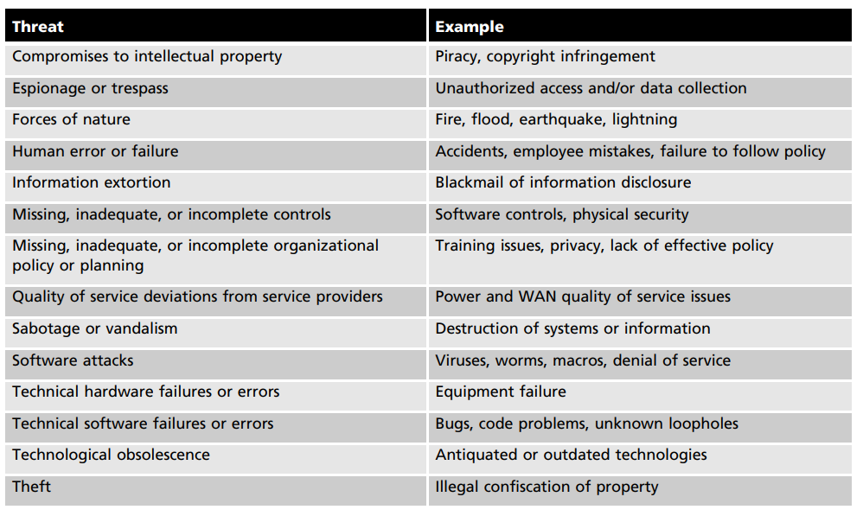
Identifying and Prioritizing Threats

Slide 19
Risk assessment
Risk assessment: is the determination of the extent to which the organization’s information assets are exposed or at risk
Likelihood: is the possibility of a potential risk occurring, interpreted using qualitative values such as low, medium, or high

Slide 20
Risk Control Strategies
Defend
Transfer
Mitigate
Accept
Terminate

Slide 21
Risk Control Strategies(Defend)
The defend control strategy attempts to prevent the exploitation of the vulnerability
This is the preferred approach and is accomplished by means of countering threats, removing vulnerabilities from assets, limiting access to assets, and adding protective safeguards
There are three common methods used to defend:
Application of policy
Education and training
Application of technology

Slide 22
Risk Control Strategies(Transfer)
Transfer control strategy attempts to shift risk to other assets, other processes, or other organizations
For example, organizations want Web services, including Web presences, domain name registration, and Web hosting.
Rather than implementing their own servers and hiring their own Webmasters, Web systems administrators, and specialized security experts, savvy organizations hire an ISP or a consulting organization to provide these products and services for them.
This allows the organization to transfer the risks associated with the management of these complex systems to another organization that has experience in dealing with those risks

Slide 23
Risk Control Strategies(Mitigate)
mitigate control strategy attempts to reduce the impact caused by the exploitation of vulnerability through planning and preparation
This approach requires the creation of three types of plans:
the incident response plan
the disaster recovery plan
the business continuity plan

Slide 24
Risk Control Strategies(Accept)
The accept control strategy is the choice to do nothing to protect a vulnerability and to accept the outcome of its exploitation
Determined the level of risk
Assessed the probability of attack
Estimated the potential damage that could occur from attacks
Performed a thorough cost benefit analysis
Evaluated controls using each appropriate type of feasibility
Decided that the particular function, service, information, or asset did not justify the cost of protection

Slide 25
Risk Control Strategies(Terminate)
The terminate control strategy directs the organization to avoid those business activities that introduce uncontrollable risks
By terminating the questionable activity, the organization reduces the risk exposure

Slide 26
Selecting a Risk Control Strategy
Feasibility Studies Before deciding on the strategy (defend, transfer, mitigate, accept, or terminate) for a specific vulnerability, the organization must explore all the economic and noneconomic consequences of the vulnerability facing the information asset

Slide 27
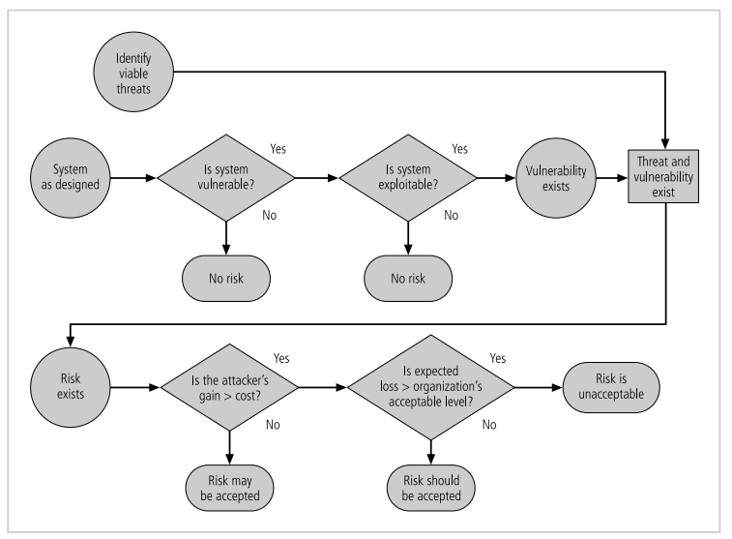
Risk Handling Decision Points

Slide 28
Cost Benefit Analysis (CBA)
Organizations must consider the economic feasibility of implementing information security controls and safeguards
Most organizations can spend only a reasonable amount of time and money on information security
Organizations are urged to begin the cost benefit analysis by evaluating the worth of the information assets to be protected and the loss in value if those information assets were compromised by the exploitation of a specific vulnerability
The formal decision making process is called a cost benefit analysis or an economic feasibility study
CBA determines whether or not a particular control is worth its cost

Slide 29
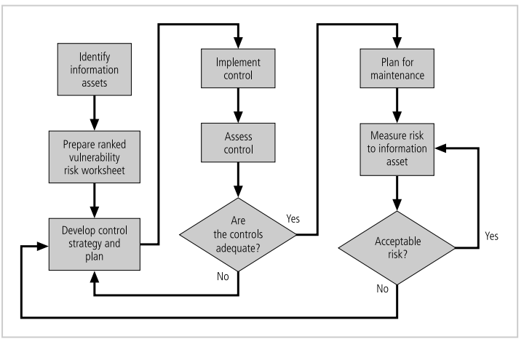
Evaluation, Assessment, and Maintenance of Risk Controls

